Slide 1



Webinar
January 30th
How to Maximize Net Profits in Workers Comp and Back Office:
Strategies for Success
Notes:
Double-click to go to next slide.

Slide 2

Lee Castine
VP, VensureHR Staffing Alliance
Focus on Employee Retention
Embrace Recruitment Process Outsourcing (RPO)
Offer Competitive Benefits
Monitor Key Performance Indicators (KPIs)
Stay Informed About Industry Trends

Slide 3




Focus on Employee Retention
Employee retention is key to controlling costs and maintaining productivity.
Develop programs and strategies to retain your best employees.
Satisfied employees will lead to satisfied clients.
Embrace Recruitment Process Outsourcing (RPO)
RPO can provide cost-effective and efficient recruiting solutions.
Consider using RPO for on-demand recruiters, project-based recruitment, or full-service RPO.
RPO can help you find the right talent faster and more efficiently.
Offer Competitive Benefits
Benefits are an important factor in employee satisfaction and retention.
Offer a variety of benefits, including health insurance, retirement plans, and paid time off.
Consider offering perks such as telehealth, employee discounts, and payroll advance options.

Slide 4
Monitor Key Performance Indicators (KPIs)
Track KPIs such as fill rate, time-to-fill, and employee turnover to measure your staffing company's performance.
Use KPIs to identify areas for improvement and track progress over time.
Stay Informed About Industry Trends
Stay up-to-date on the latest industry trends and best practices.
Attend industry events, read industry publications, and participate in online forums.
Remember, the key to success in the staffing industry is to focus on providing excellent service to both clients and employees. By implementing these strategies, you can improve your staffing company's bottom line while maintaining a commitment to quality and customer satisfaction.

Slide 5

Matt Kaplan
Division President | Sunset Cove
Maximizing profit by ensuring accuracy during the Pay Bill process
What reports to review before processing payroll in your ATS
  Pre Gross Margin Report
  Tax Advantages

Slide 6
Maximizing profit by ensuring accuracy during the Pay Bill process.
90% of mistakes in the pay bill process come from reusing old job orders and not ensuring the information is correct. Below are three ways that these kinds of mistakes can affect your bottom line.
If the wrong workers comp code is used on an assignment and processed, you could probably change it when submitting to your workers comp carrier but in your gross margin inside your ATS it will be wrong. You are making financial decisions off that information. Comparing year over year data. Paying commissions to salespeople or Division presidents and now it will either be inflated or underestimated depending on the mistake.
A wrong invoice to a client increases the time in which you get paid. Most staffing firms borrow money from a factoring company or a line of credit. Revising invoices during that process can cause problems with the factoring company which costs you money! In addition. Usually, clients get 30 days from the corrected invoice to pay. Which means they are charging you more interest! Finding mistakes before a client is past due saves valuable money and time!
Overpayment to candidates that you will never get back. Staffing has a high rate of turnover! Once a payment goes out to a temp that is incorrect the likelihood you will receive it back is not likely. That was making sure all the information is correct is key.

Slide 7



What reports to review before processing payroll in your ATS
Pre Gross Margin report: This report is inside every ATS and allows you to look at the information that has been entered before payroll and billing is processed.
  In Avionte – it is called the grid. You can export the grid.
  In ABD. It is a pre gross margin report with burden
  In Aqore it is also a grid.
Tax advantages: Anyone that qualifies for these programs are more profitable than a regular employee.
  WOTC
  NY Youth Credit -other states have other programs
  Empowerment Zones

Slide 8

Scott Black
Sr. Vice President of Loss Control
Loss control - staffing
Maximizing net profits
Establish the partnership
Strategies for success
Managing workplace injuries

Slide 9

Essential steps for temporary workers program:
Establish written guidelines and protocols.
Develop a program for preventing injuries and illnesses.
Conduct hazard assessments at job sites.
Utilize a checklist for onboarding new hires and conducting onsite evaluations.
Provide documented training for temporary staff at the worksite.
Ensure reporting, investigation, and recordkeeping of injuries and illnesses.
Conduct regular reviews of claims with the host and workers' compensation provider.
Establish the partnership
LOSS CONTROL - STAFFING - MAXIMIZING NET PROFITS - STRATEGIES FOR SUCCESS

Slide 10
Establish constant communication
Claims reporting procedures
Conduct documented injury investigations
Return to work
Alternative light duty
Managing workplace injuries
LOSS CONTROL - STAFFING - MAXIMIZING NET PROFITS - STRATEGIES FOR SUCCESS

Slide 11
Proper Classification & Why it Matters
Why is it important to have a prospect/client correctly coded for WC?
Although we all want to have the lowest rate possible charged for our work, accuracy in classification far outweighs the potential “savings” from improper classifications. Proper classification is important upfront because of the variability of WC rates. Each code is individually rated based on historical data related to the industry associated.
Consider this Scenario
We have an IT operation that is classified to 8810 clerical based on a general description of the risk and no further research. Later, it is determined many employees are out in the field installing hardware on computers. This differentiation in work means the employees would be correctly coded to 5191 office machine install, inspection, adjustment, and repair. Having discovered this misclassification, it is now the carriers purgative and responsibility to audit your employees for proper classification and adjust the billing of premium to reflect this change. If you started the opportunity with a cost rate for 8810 of 0.20 and the rate for 5191 was 1.00 you would now have an increase in cost of five times your original expectation. Now you are facing increased cost on the work moving forward AND likely money due at audit. This error in classification now impacts your cash flow and bottom line. It also would have an impact on your ExMod if not caught and corrected as your carrier would be reporting wages under a much lower rated code than it should be meanwhile the claims associated align more normally with the industry specific to 5191 not 8810 thus rapidly increasing your ExMod.

Slide 12
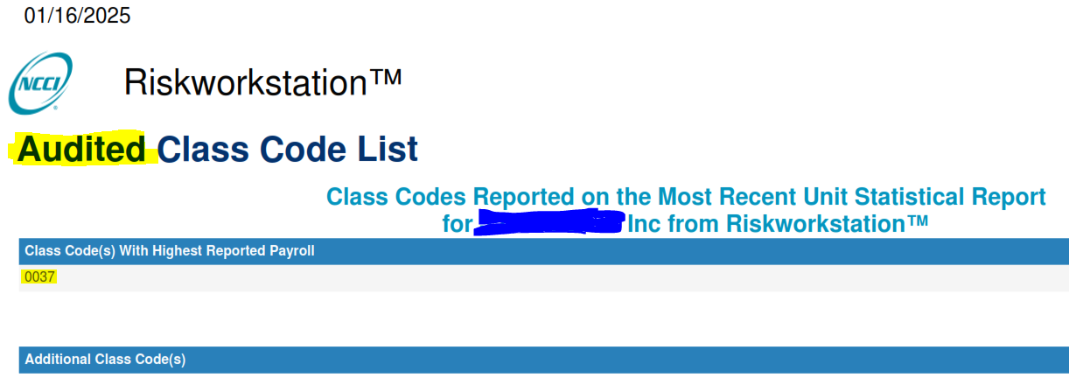
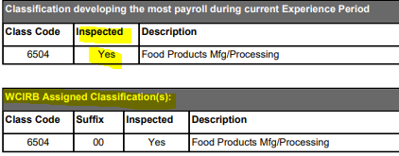
Proper Classification & Why it Matters
What can I do?
Request a client’s risk summary report from the rating bureau
  This will identify the inspected class codes the rating bureau has found
  Have your client’s request site inspections of their business from the rating bureau to verify proper classification (these visits are solely focused on classification and could improve the client’s future costs through verification of the work and codes associated).
Make sure your job positions line up with the codes being associated to them in your agreements and when processing
Ask your broker, carrier or an insurance professional

Slide 13
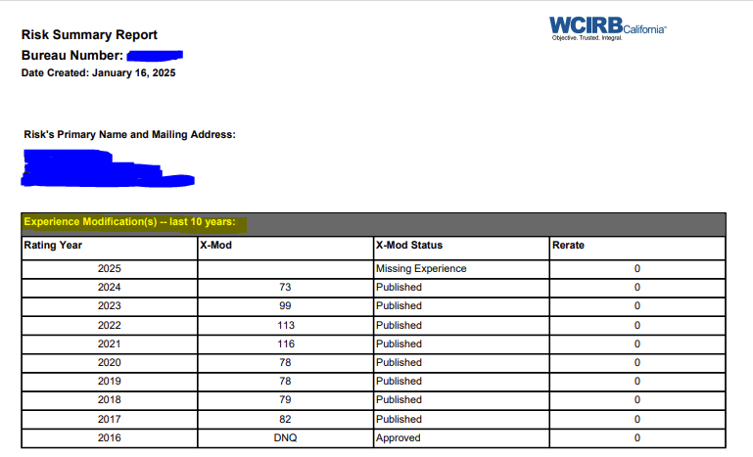
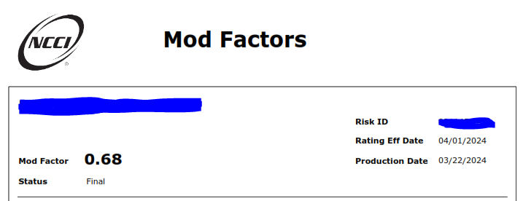
What is an experience modification rate (ExMod)?
An experience modification rate is a method of modifying an employers’ workers’ compensation premiums based on their personal loss history. This is an employer specific multiplier that measures its loss experience relative to that of other employers in the same industry.
Who is responsible for reporting and production of an ExMod?
Your Workers Compensation carrier is responsible for the financial reporting of payroll and claims applicable to each rating period. It is the National Council of Compensation Insurance’s (NCCI) responsibility for most states to promulgate the data provided by the carriers and produce the applicable ExMod for each client. There are several states that have their own separate rating bureau not beholden to NCCI that would own this responsibility in their respective state (CA, NJ, NY, PA, etc.)
How is an ExMod earned and calculated?
The experience modifier is calculated based on a formula involving payroll and losses for each policy holder. The experience period used in calculating an experience modifier for a risk is generally three complete years of loss experience ending one year before the modification’s effective date, not including the current policy year.
Why is an experience modifier important?
Good experience leads to lower premiums; bad experience leads to higher premiums. ExMods also measure your business against competitors and in some instances can disqualify you from business opportunities where a certain standard (typically <=1.00) is required (think government contracts). ExMods are also a good barometer when looking to staff new opportunities to understand the performance and safety culture of a prospective client.
Leading Independent
Employer Solutions Provider

Slide 14


Q&A

Slide 15


?
Thank you for your time.
We look forward to a rewarding partnership!
Lee Castine
VP of Sales
602.620.1460
lee.castine@vensure.com
vensurestaffingalliance.com

